Slide 1
NON-NEGATIVE SPARSE CODING
by P. O. Hoyer,2002
Yunfei Wang
Sep 14,2012

Slide 2
Outline
Non-negative sparse coding
Estimating the hidden components
Learning the basis
Experiments
Proof of monotonic convergence

Slide 3
NMF
Linear Decomposition
1.columns of A contain the basis vector
2.rows of S contain the corresponding hidden component

Slide 4
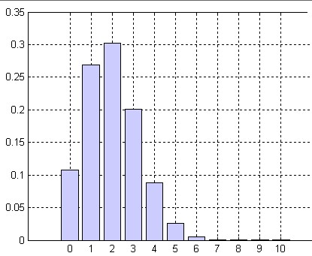
Linear Sparse Coding
Goal-Representing any given input vector using only a few significantly non-zero hidden coefficients.

Slide 5
Non-negative Sparse Coding
Both NMF and sparseness are important for learning parts-based representations.
Combining the goal of small reconstruction error of NMF with that of sparseness.

Slide 6
Estimating the hidden components
For a given basis A, the objective is convex with respect to S, so the global minimum exists.
Update rule for S:
the proof of monotonous convergence is similar to that of NMF

Slide 7
Learning the basis
Consider the optimization of A, holding S fixed
Updating steps of A:
1.
2. Set all the negative values in A^{t+1} to zero.
3. Rescale each column of A^{t+1} to unit norm.

Slide 8
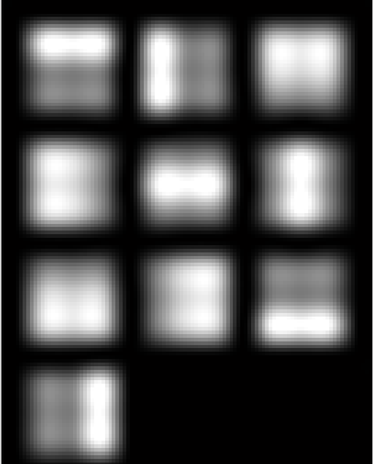
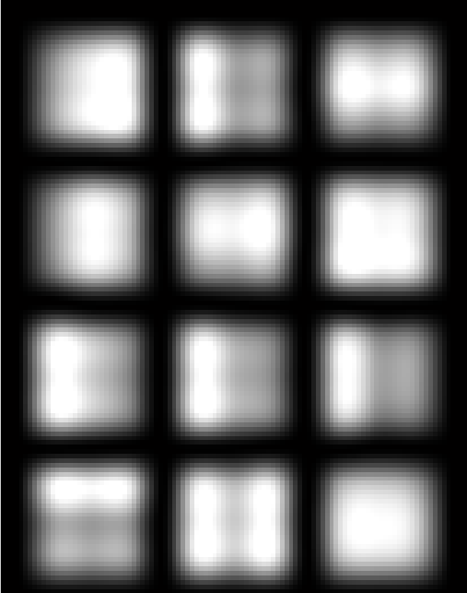
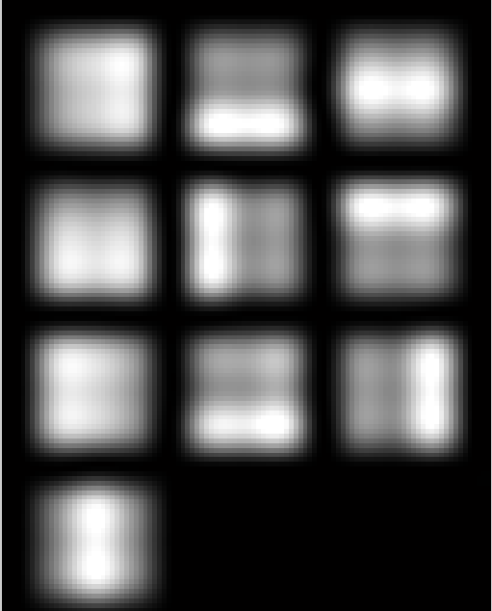
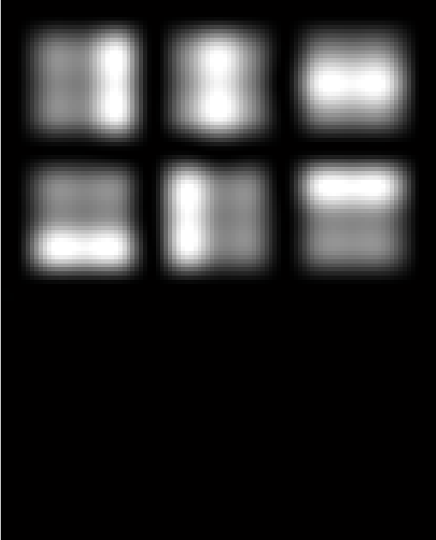
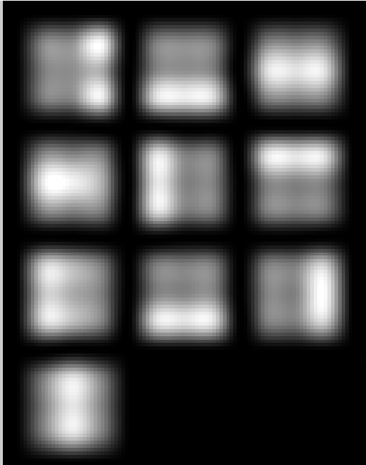
Experiments-learning basis
Features Samples
NNSC NMF(6) NMF(10)

Slide 9
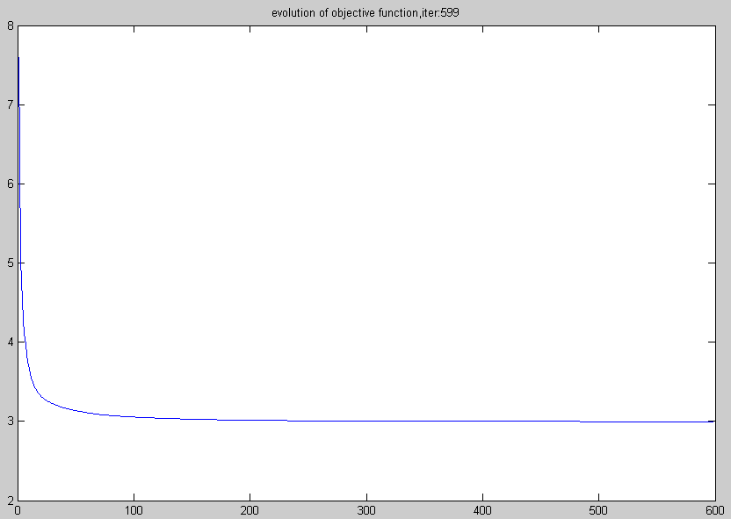
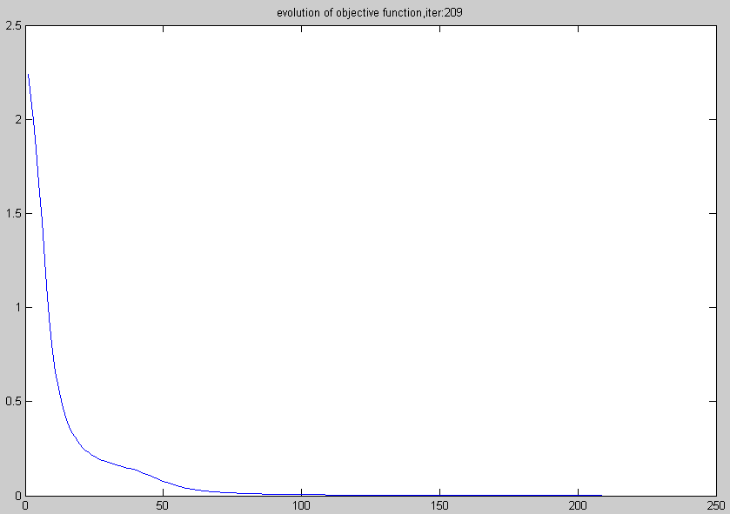
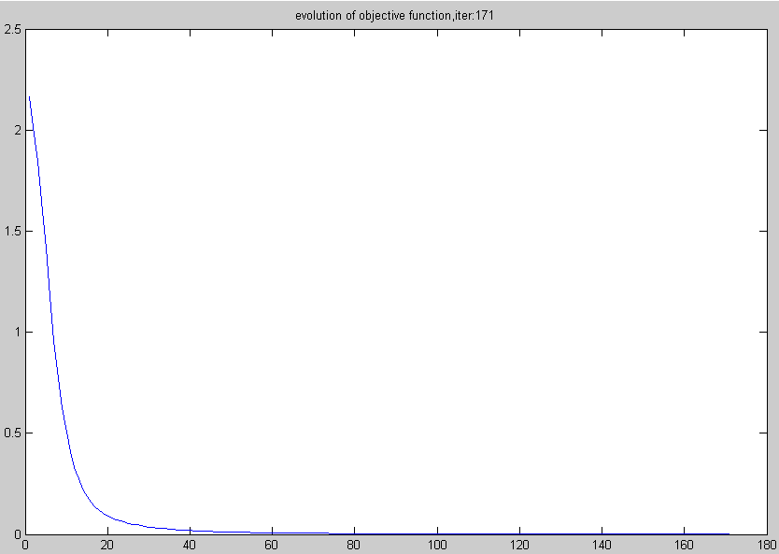
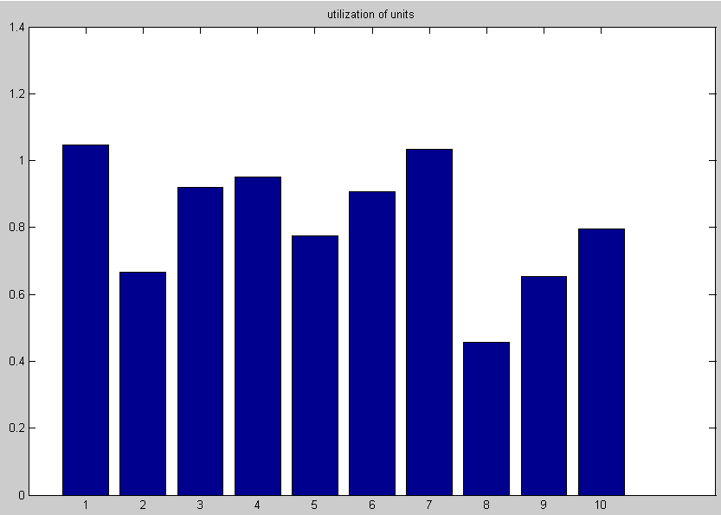
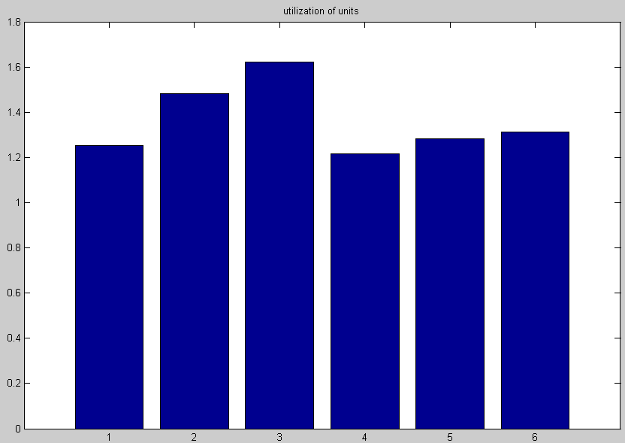
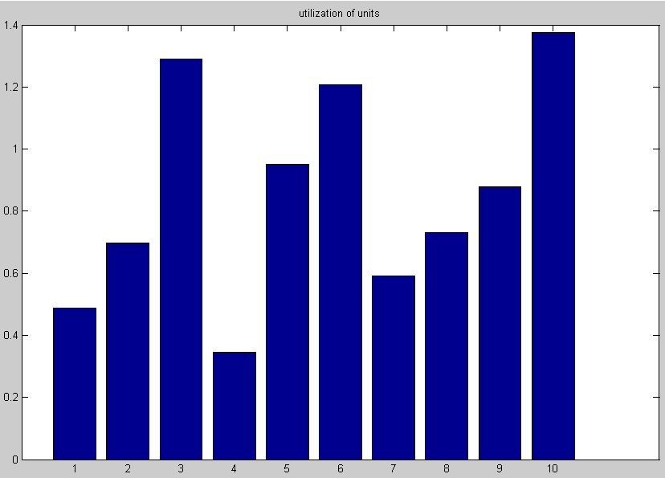
Experiments convergence and hidden components
NNSC NMF(6) NMF(10)
[583]:2.94223/4.11878 [209]: 0.00129 / 0.00000 [171]: 0.00097 / 0.00000

Slide 10
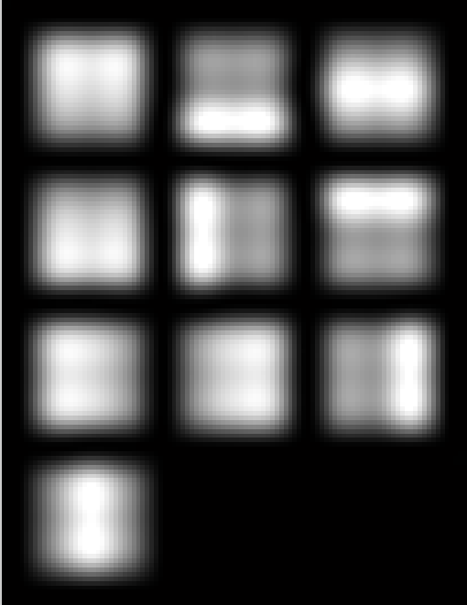
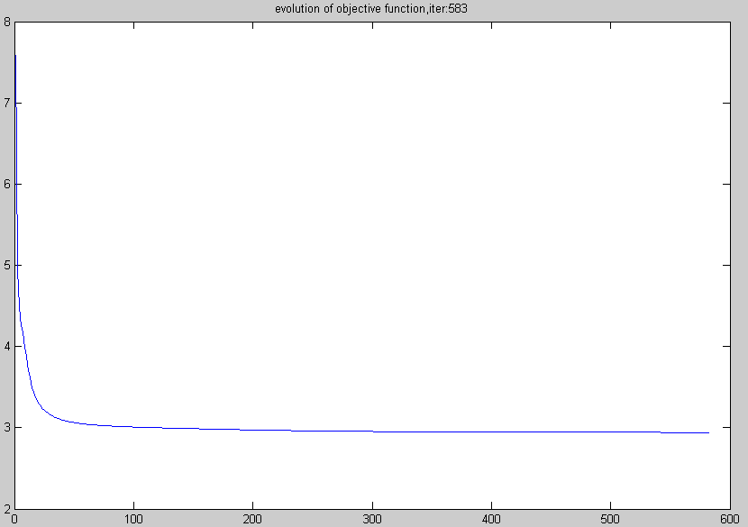
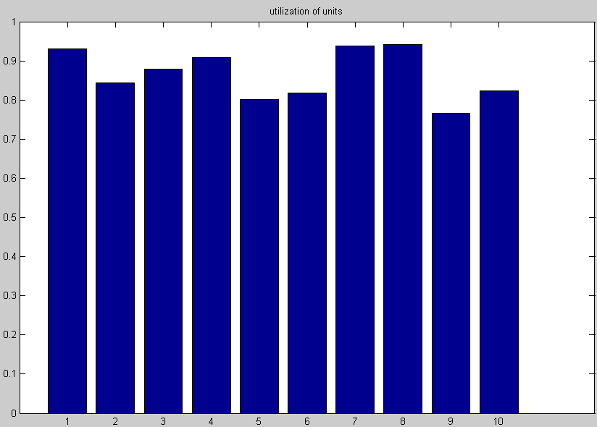
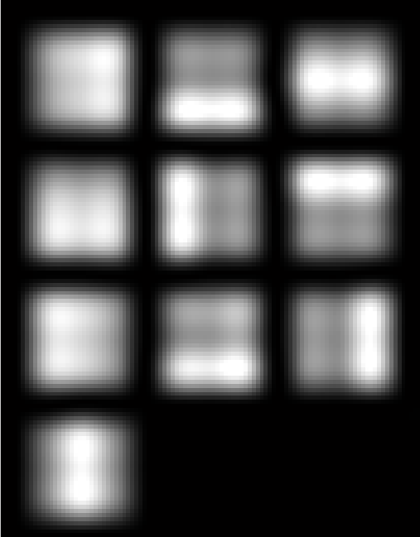
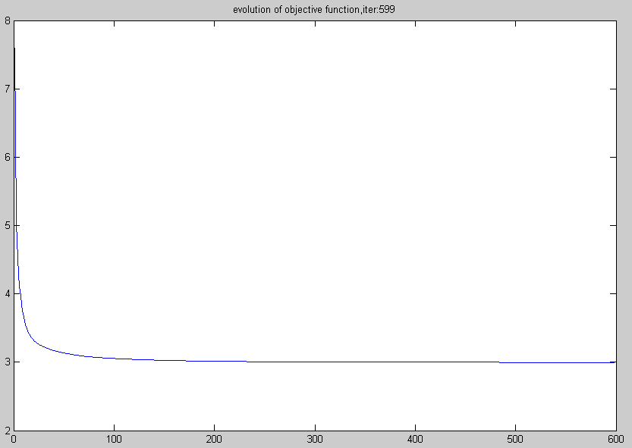
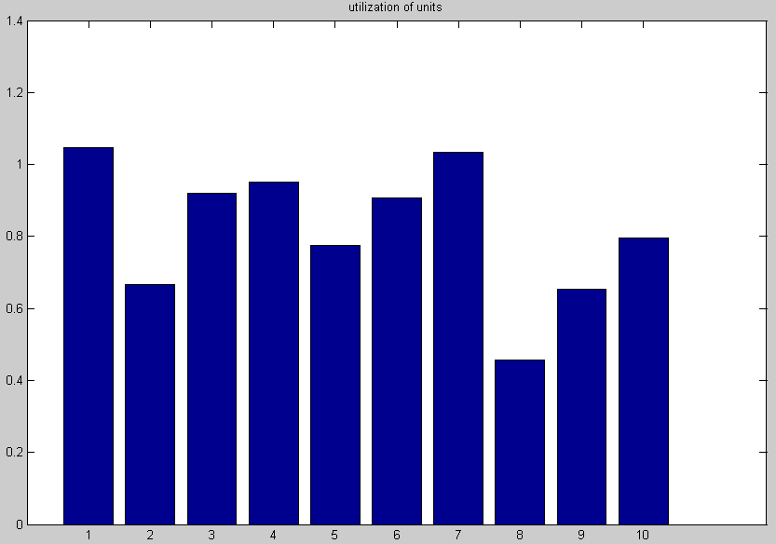
Experiments-Change NNSC a little
2.94223/4.11878 583
NNSC
2.99647/4.11878 599
Changed NNSC

Slide 11
Three problems remained of NMF
How to get the step size(numerator and denominator )?
How to handle the concave case?
How to construct auxiliary function?

Slide 12
Proof of monotonic convergence(1)
Objective function:
Auxiliary function:
F(h) is convergent:
Does the auxiliary function exists?

Slide 13
Proof of monotonic convergence(2)
Constructing the auxiliary function for F(h)
Second-order Taylor expansion of F(h) at h^{t}

Slide 14
Proof of monotonic convergence(3)
Proving G(h,h^{t}) is the auxiliary function of F(h)
K(h^{t})-W^{T}W is semi-positive definite if and only if M is semi-positive definite.

Slide 15
The update rule of h

Slide 16
Handle the concave case
Solution one:
Solution two:
Converting the objective function to convex by multiple it by a negative number.

